Slide 1
JavaScript Programing
Presenter: Y.Ta
Phone : 0905.16.49.61

Slide 2
Content
Variable
Array
Operator
Function
Condition and Loop
Error and Debug
Handle Exception
How to debug on browser

Slide 3
What is Variable?
﻿A script will have to temporarily store the bits of information it needs to do its job. It can store this data in variables.

Slide 4
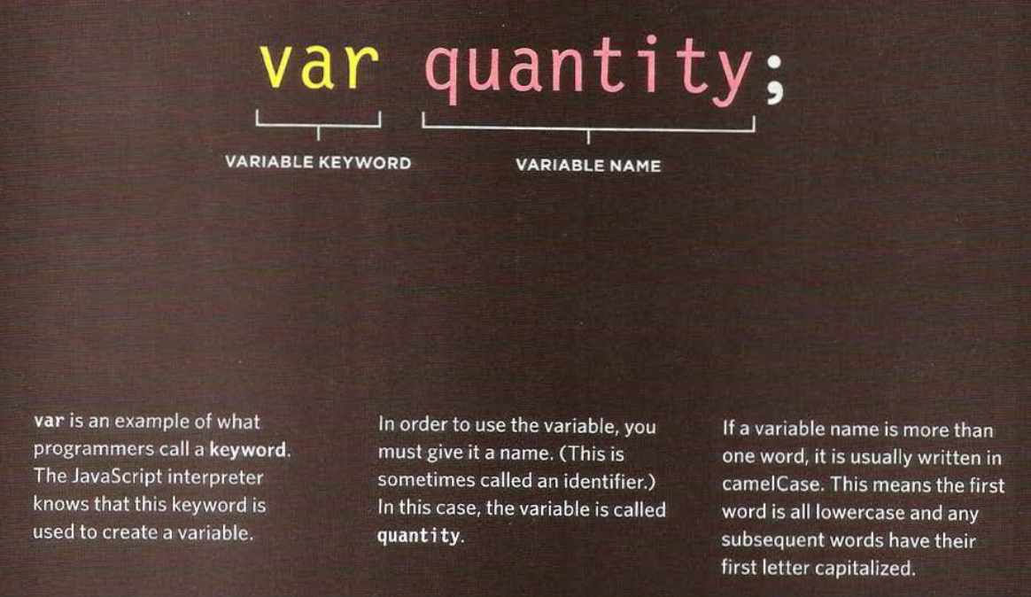
Variable : How to declare them

Slide 5
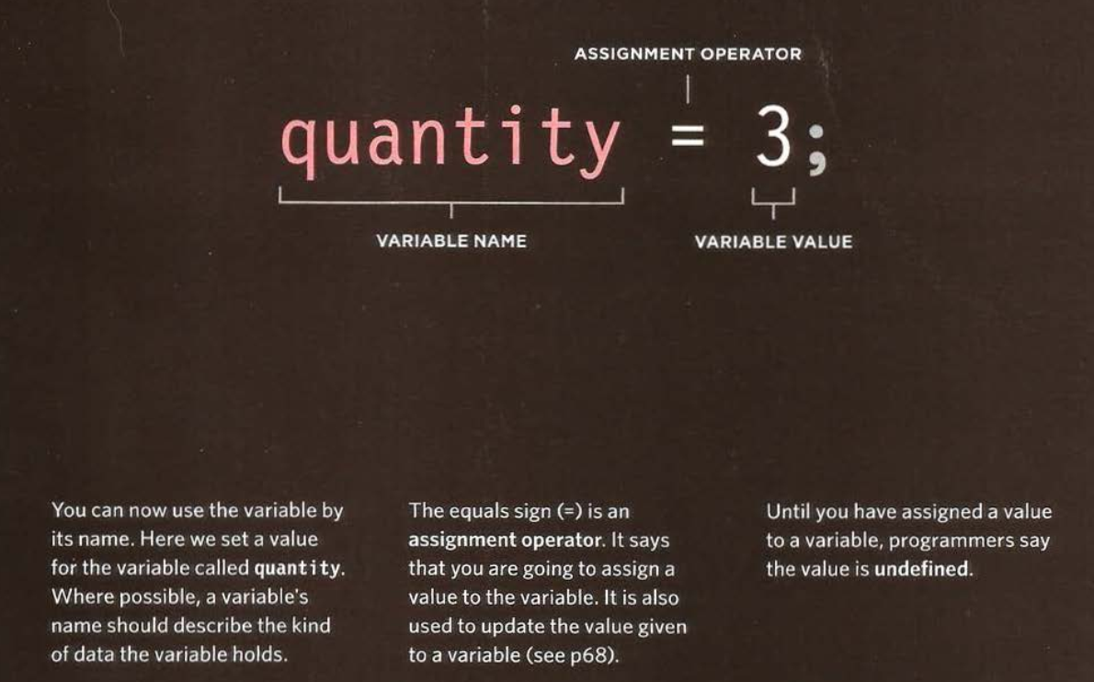
Variables : How to assign them a value
One you have created a vairable, you can tell it what information you would like it to store for you : Assign a value to ther variable

Slide 6
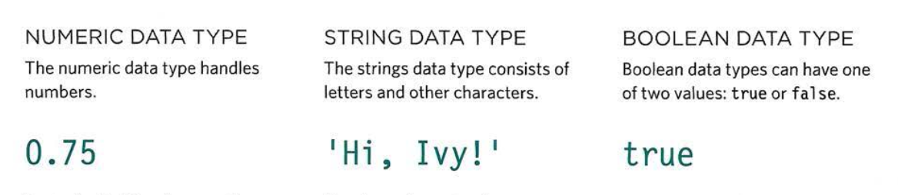
Data types

Slide 7
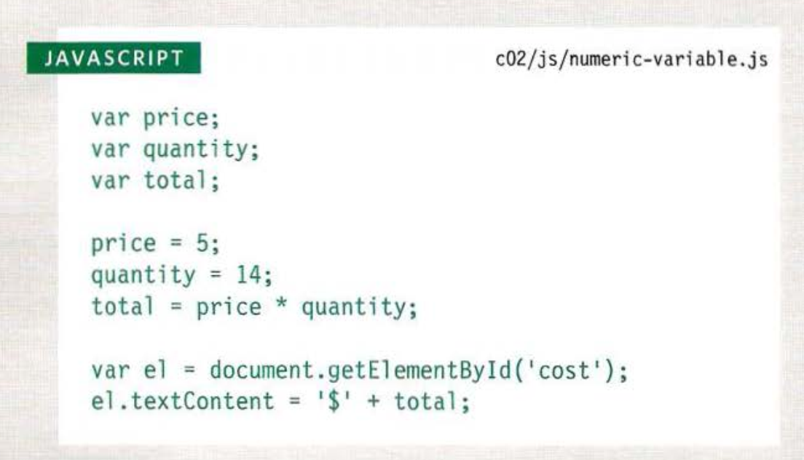
Using a variable to store a number

Slide 8
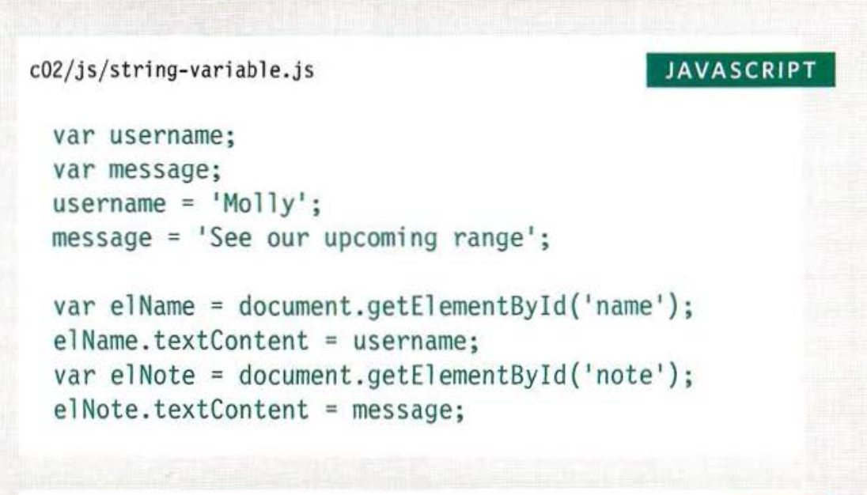
Using a variable to store a string

Slide 9
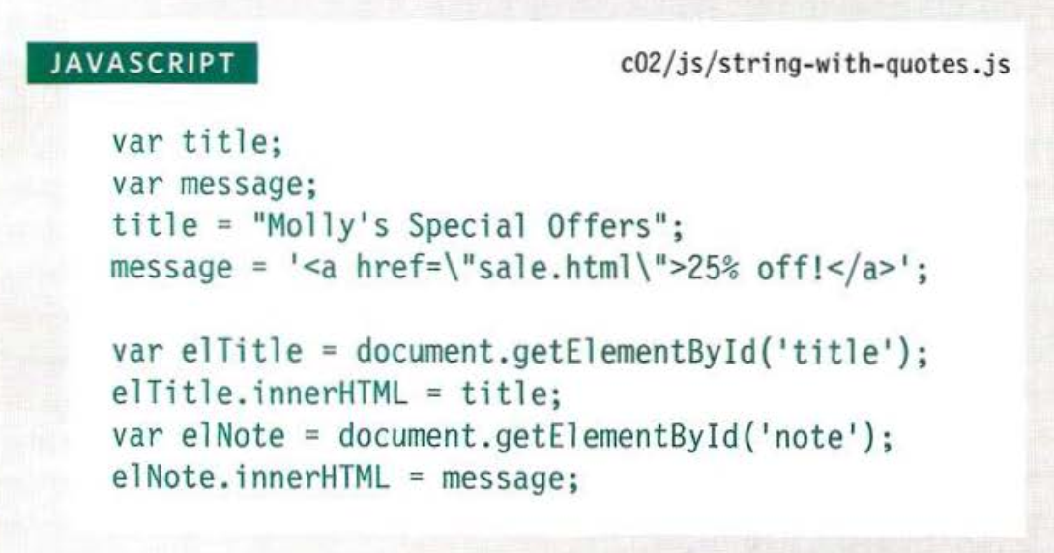
Using quotes inside a String

Slide 10
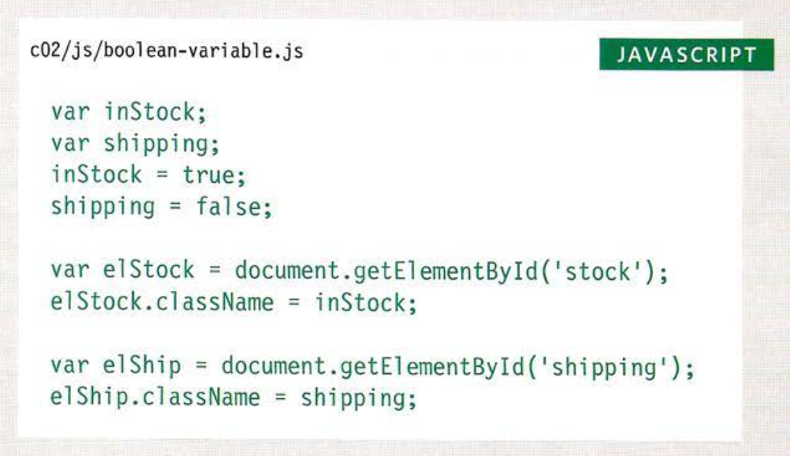
Using a Variable to store a boolean
﻿A Boolean variable can only have a value of true or false, but this data type is very helpful.

Slide 11
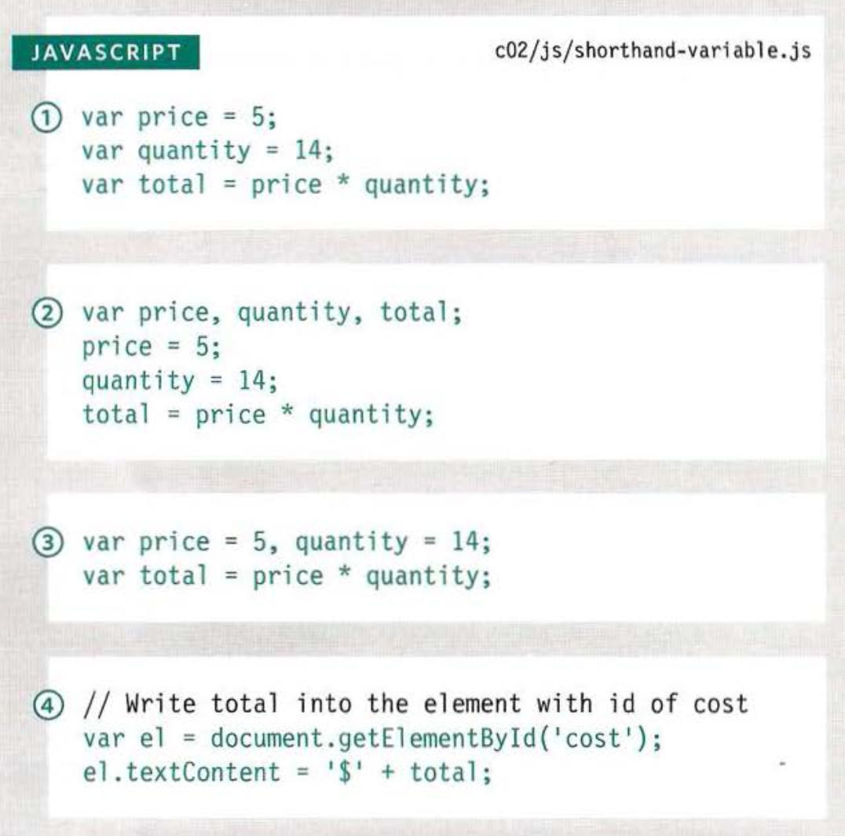
Shorthand for creating variables

Slide 12
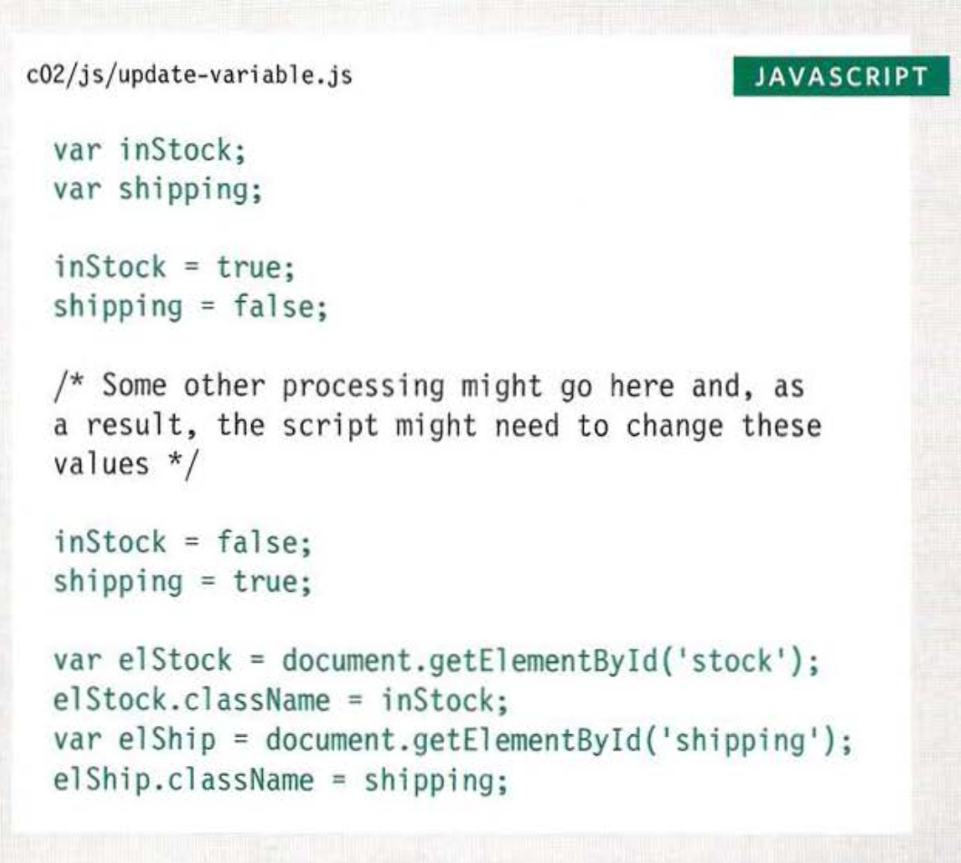
Changing the value of a variable

Slide 13
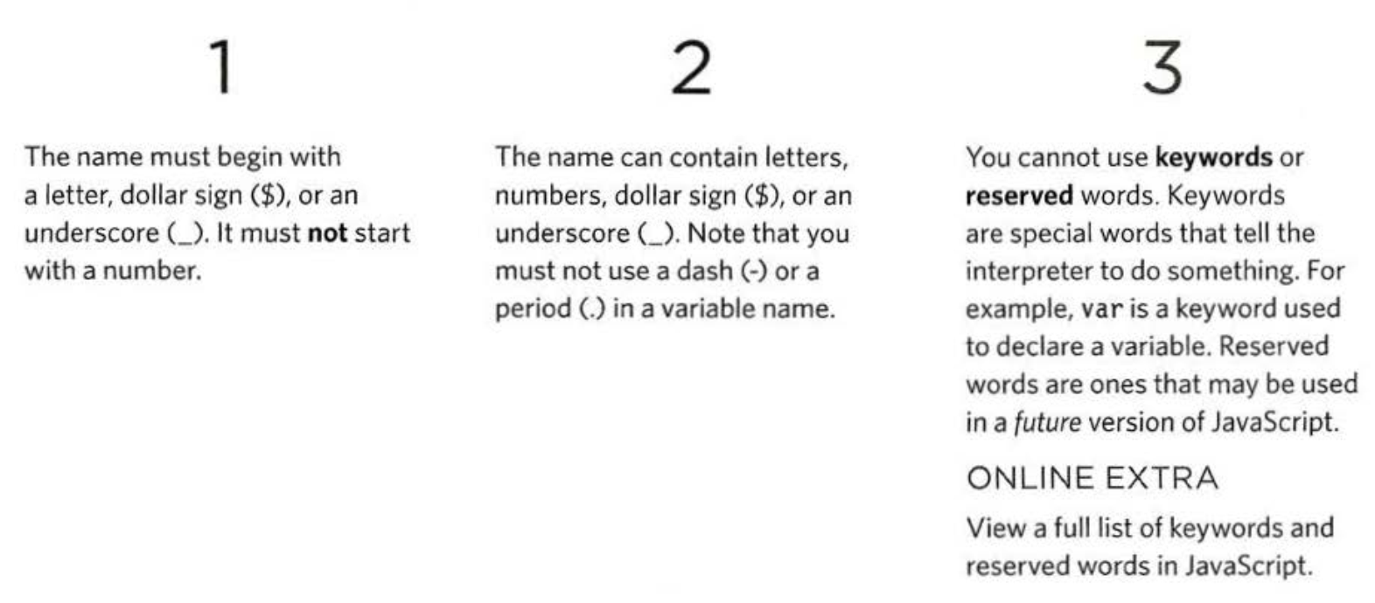
Rules for naming variables
Here are six rules :

Slide 14
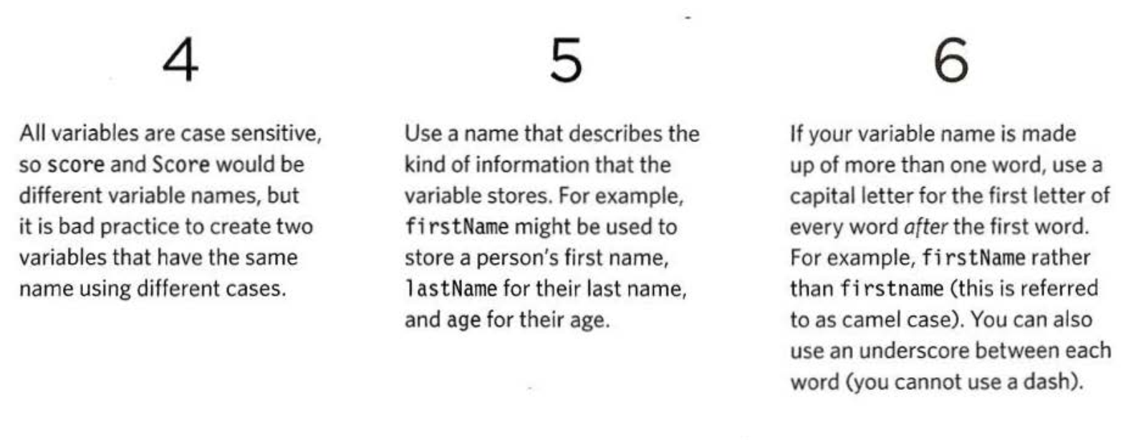
Rules for naming variables

Slide 15
﻿ARRAYS
﻿An array is a special type of variable. It doesn’t just store one value; it stores a list of values
﻿You should consider using an array whenever you are working with a list or a set of values that are related to each other.

Slide 16
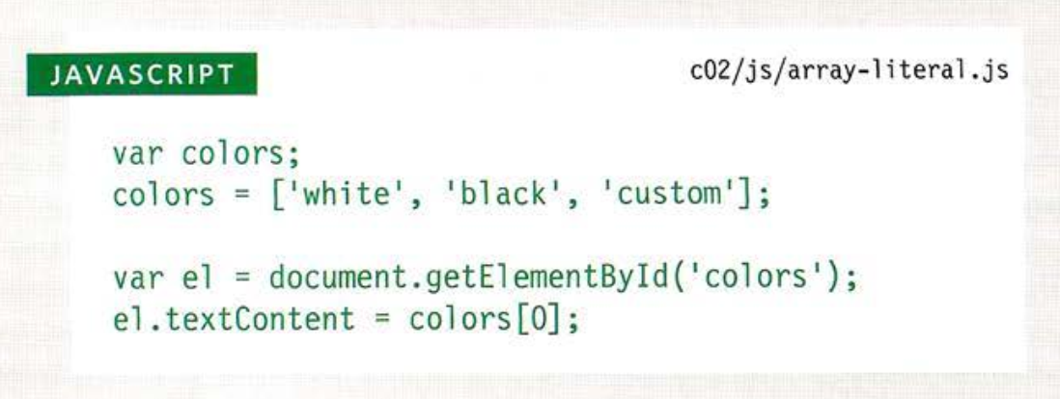
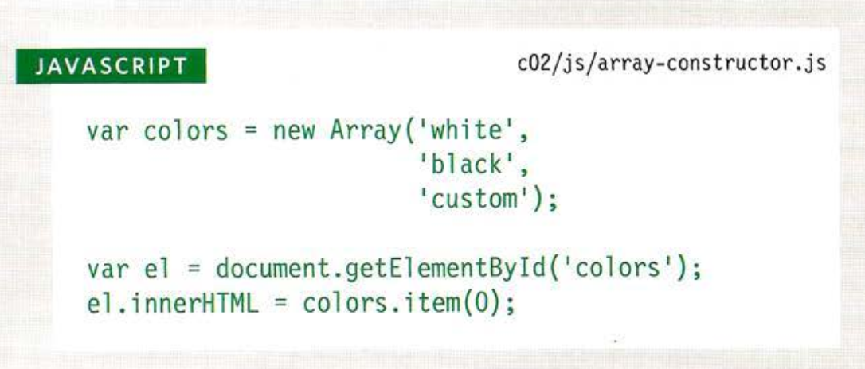
Creating an array

Slide 17
Values in Arrays
﻿Values in an array are accessed as if they are in a numbered list. It is important to know that the numbering of this list starts at zero (not one)

Slide 18
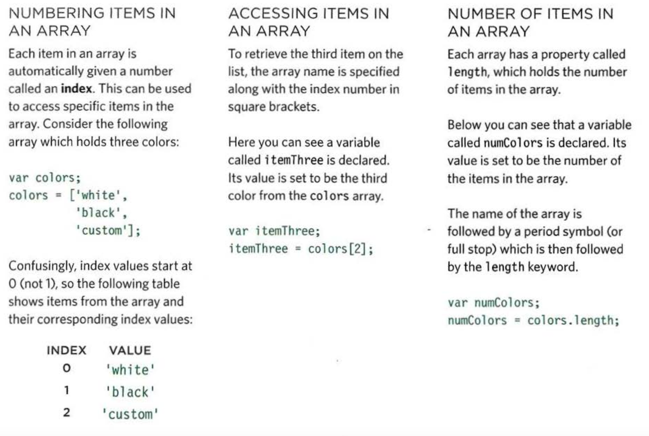
Values in Arrays

Slide 19
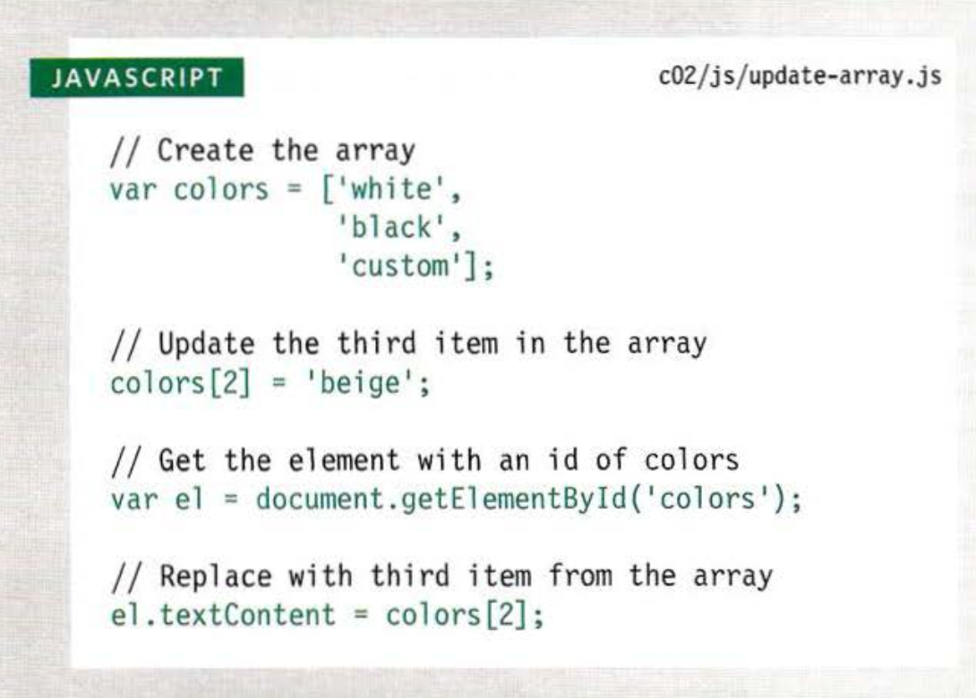
Access and change value in array

Slide 20
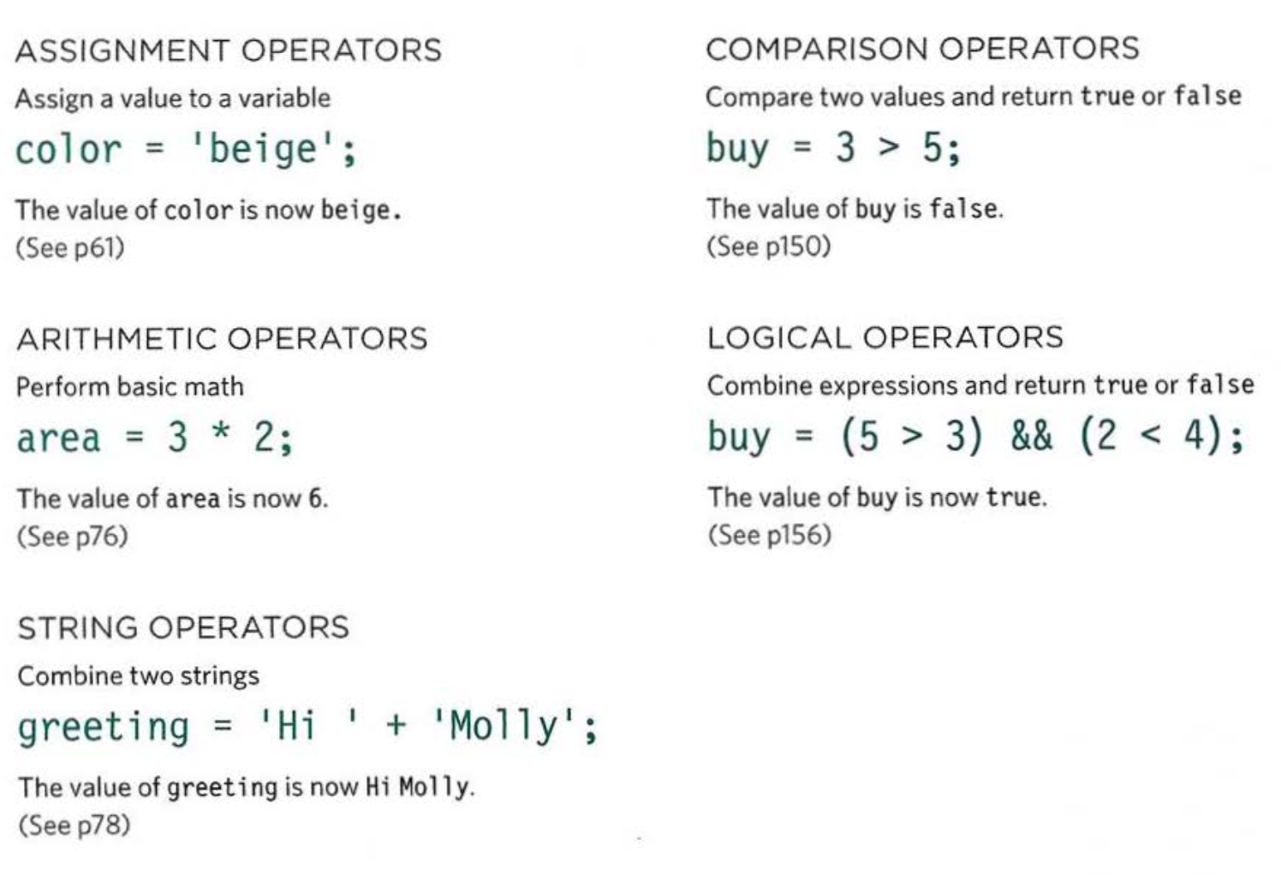
Operators

Slide 21
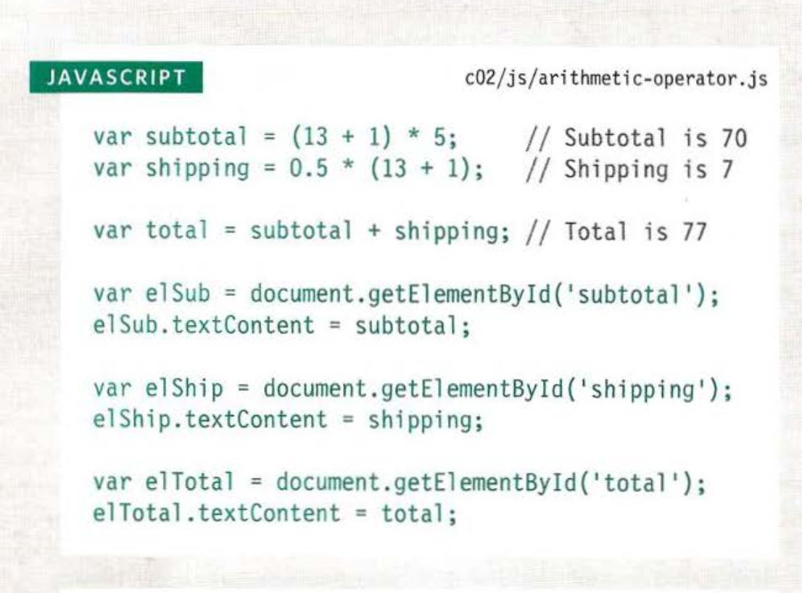
Arithmetic Operators

Slide 22
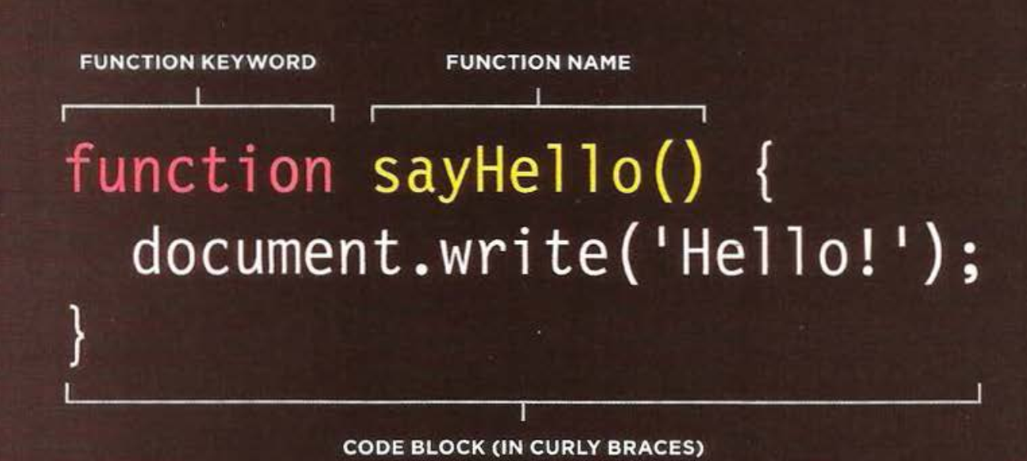
Function

Slide 23
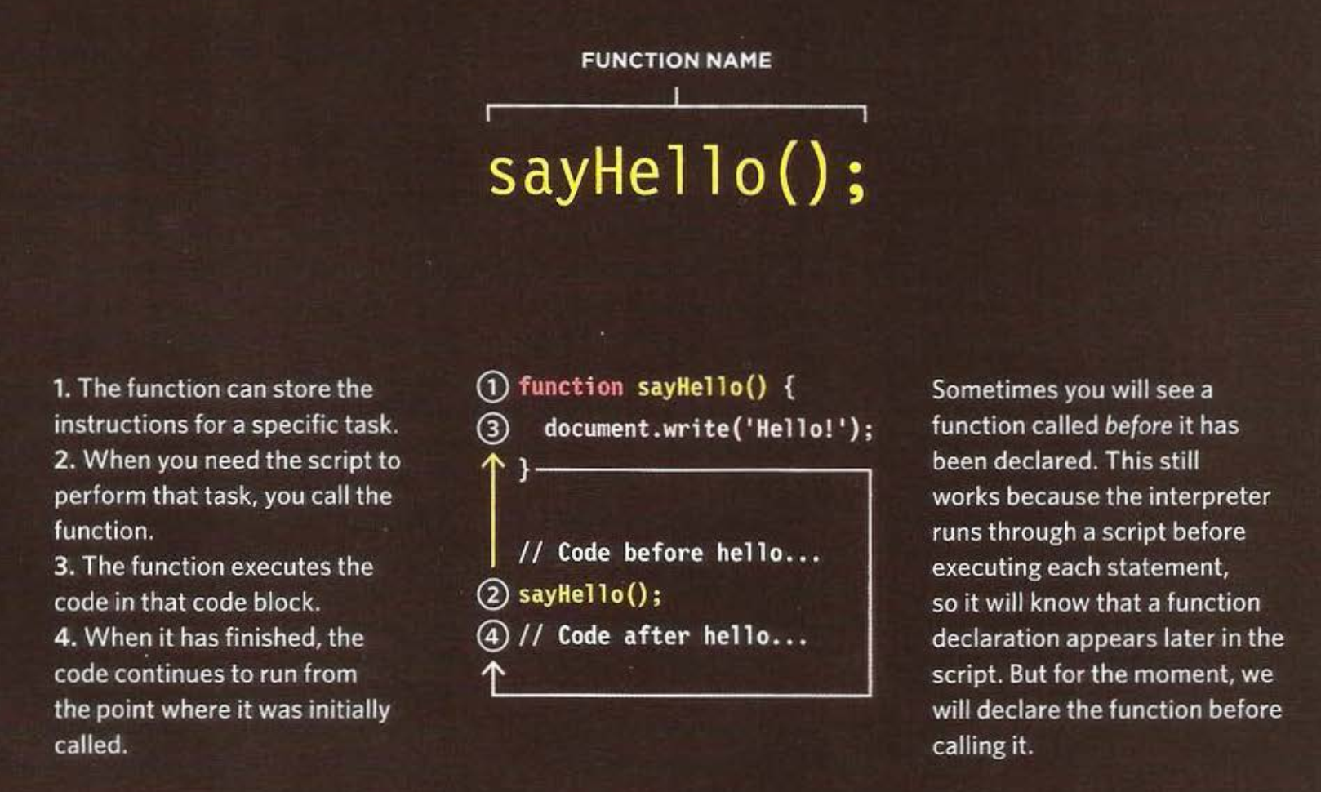
Calling function

Slide 24
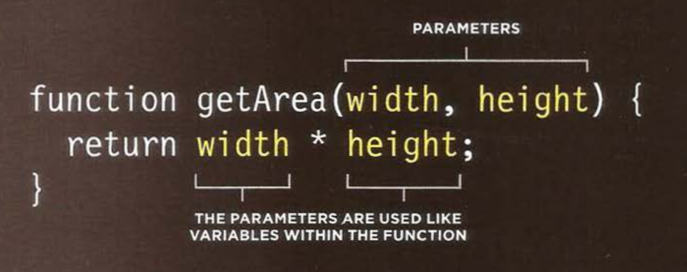
Declaring functions that need information

Slide 25
Closure
Một closure là một inner function (hàm khai báo bên trong một hàm khác), nó có thể truy cập tới các biến của outer function (hàm chứa inner function) - scope chain.
Closure có 3 scope chain, nó có thể: truy cập tới các biến khai báo bên trong nó, truy cập tới các biến của outer function, và truy cập tới các biến global.

Slide 26
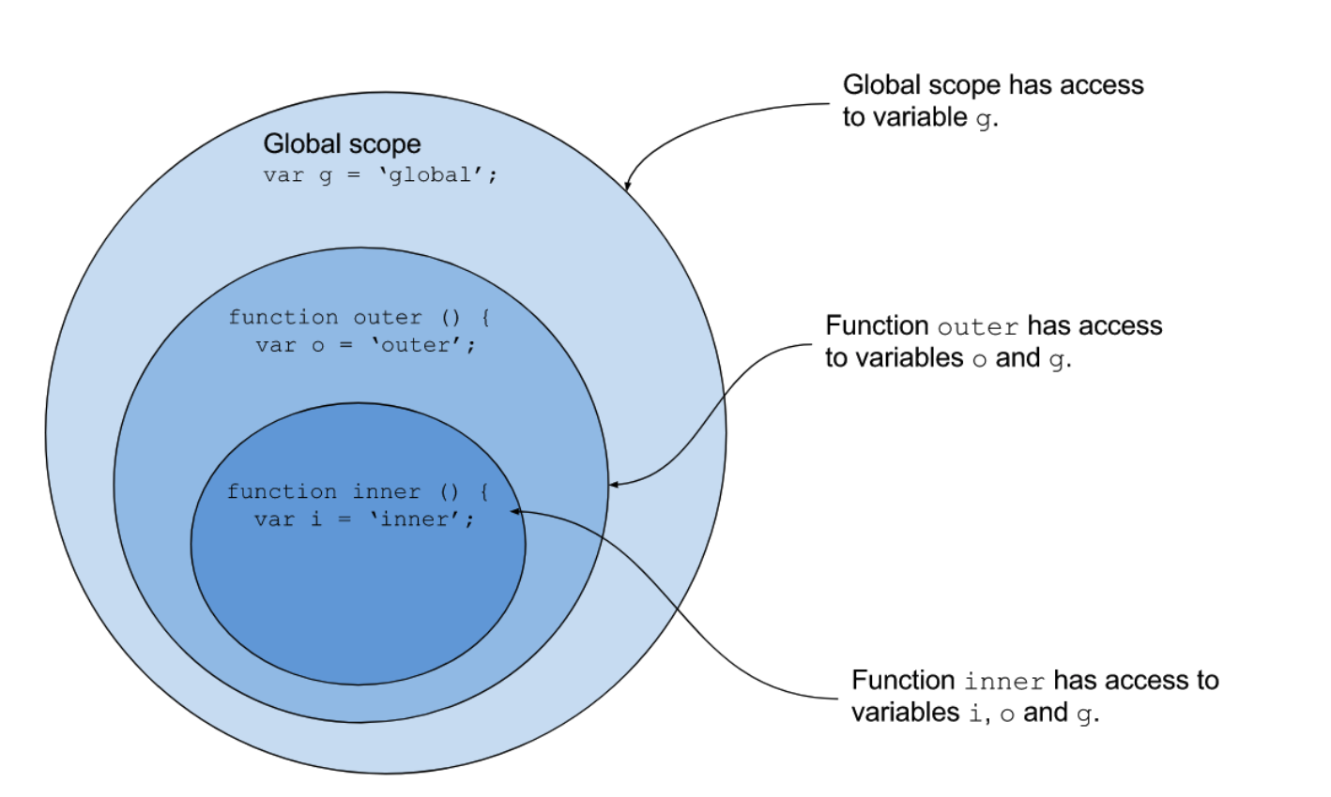
Closure

Slide 27
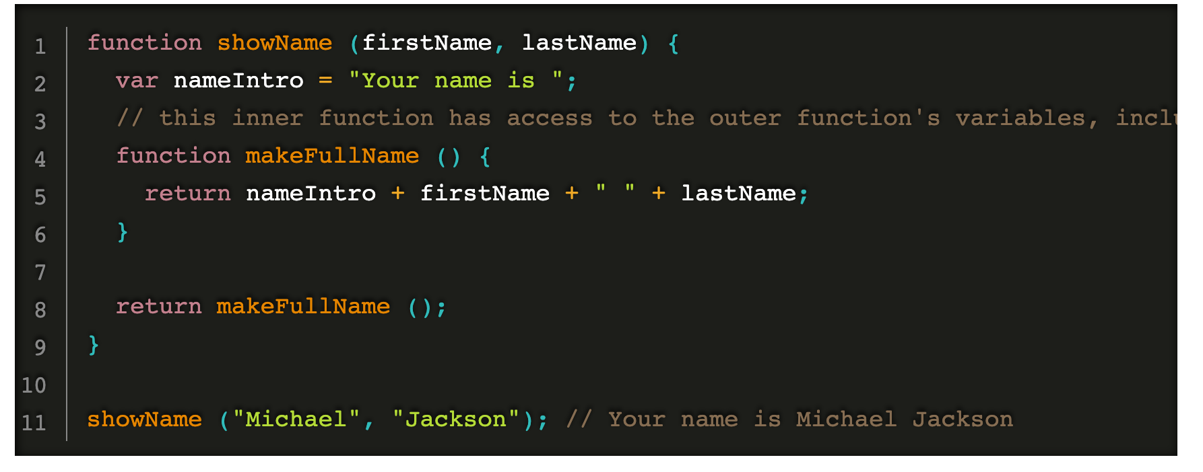
Closure example

Slide 28
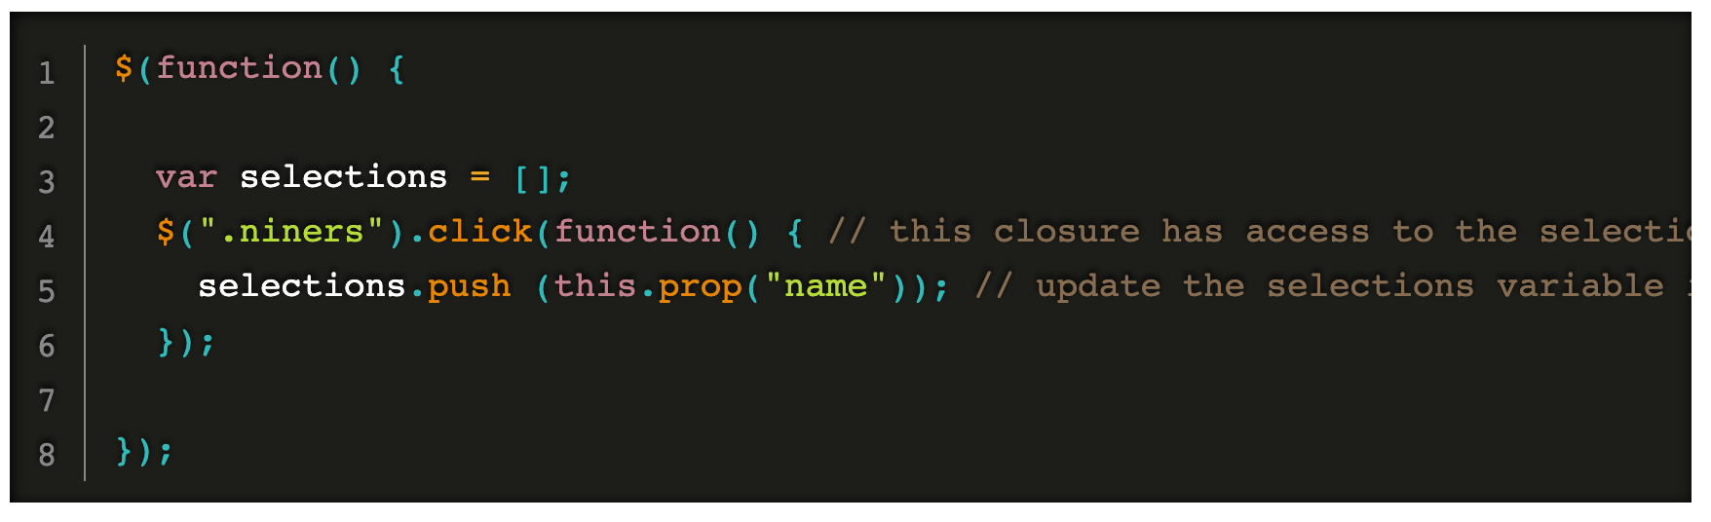
Closure in JQuery

Slide 29
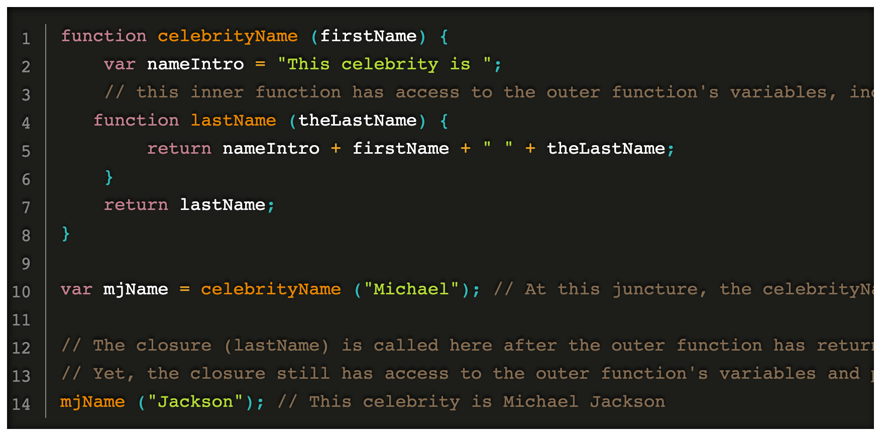
Closure can access variable of outer function when outer function return

Slide 30
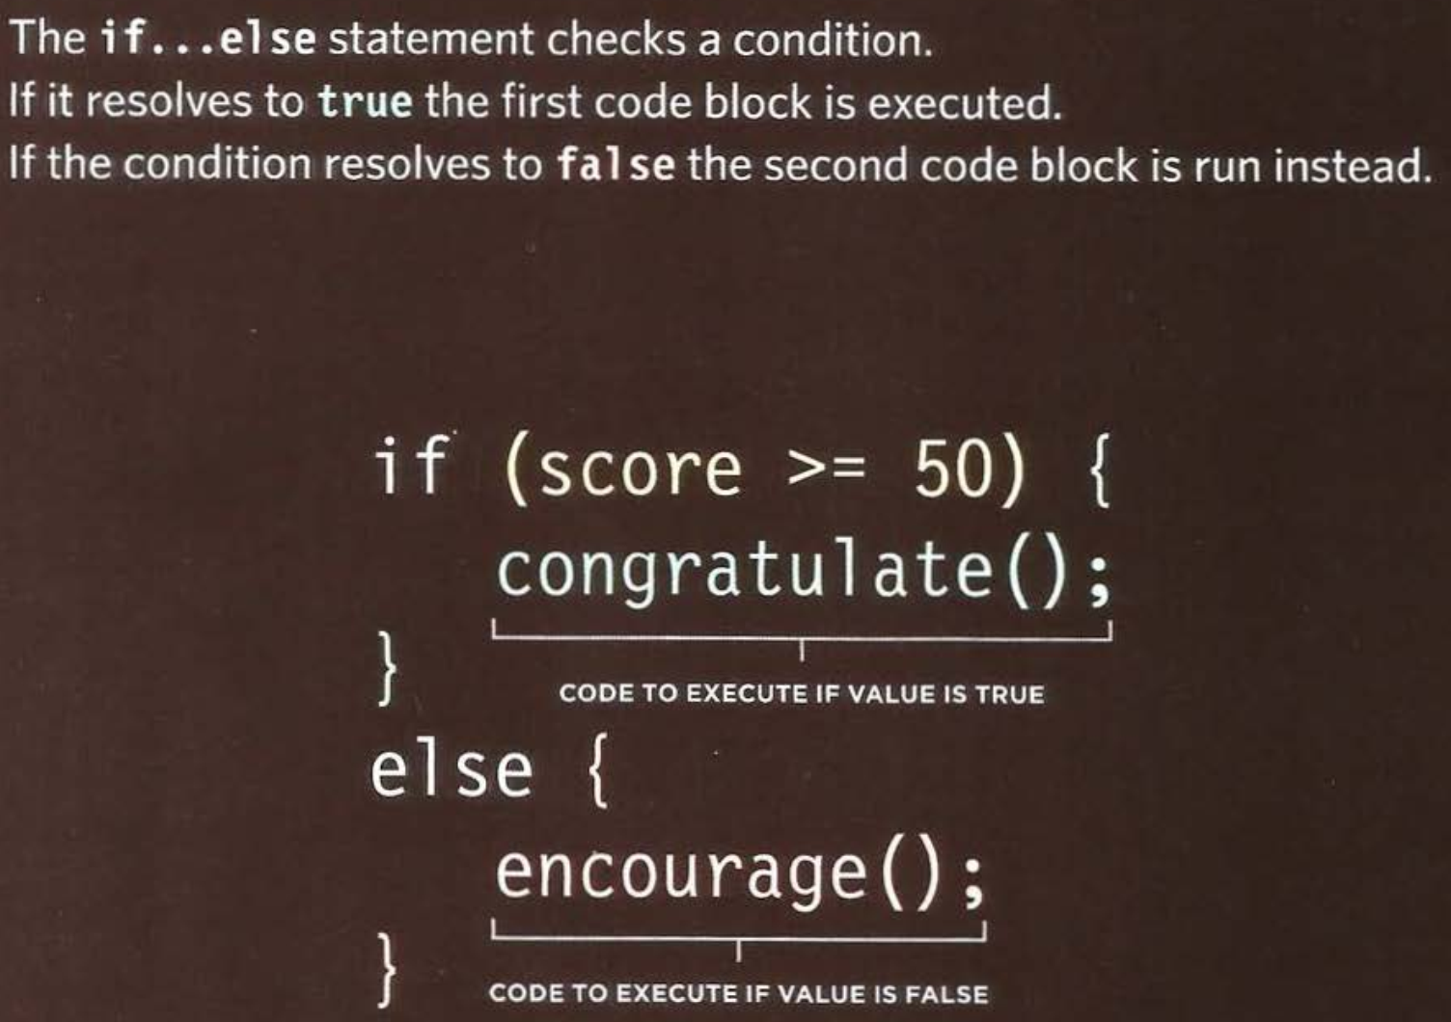
Condition

Slide 31
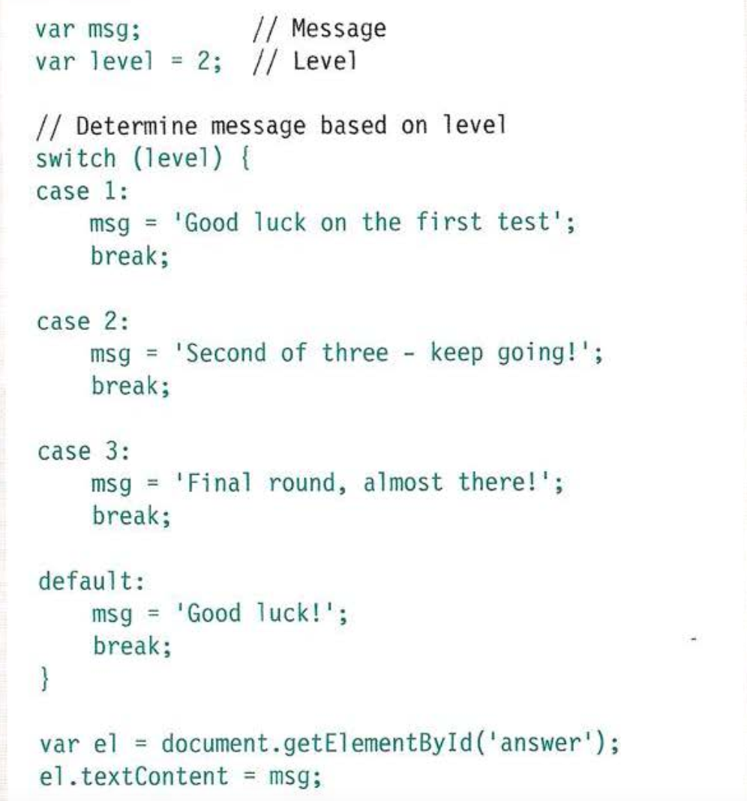
Switch statement

Slide 32
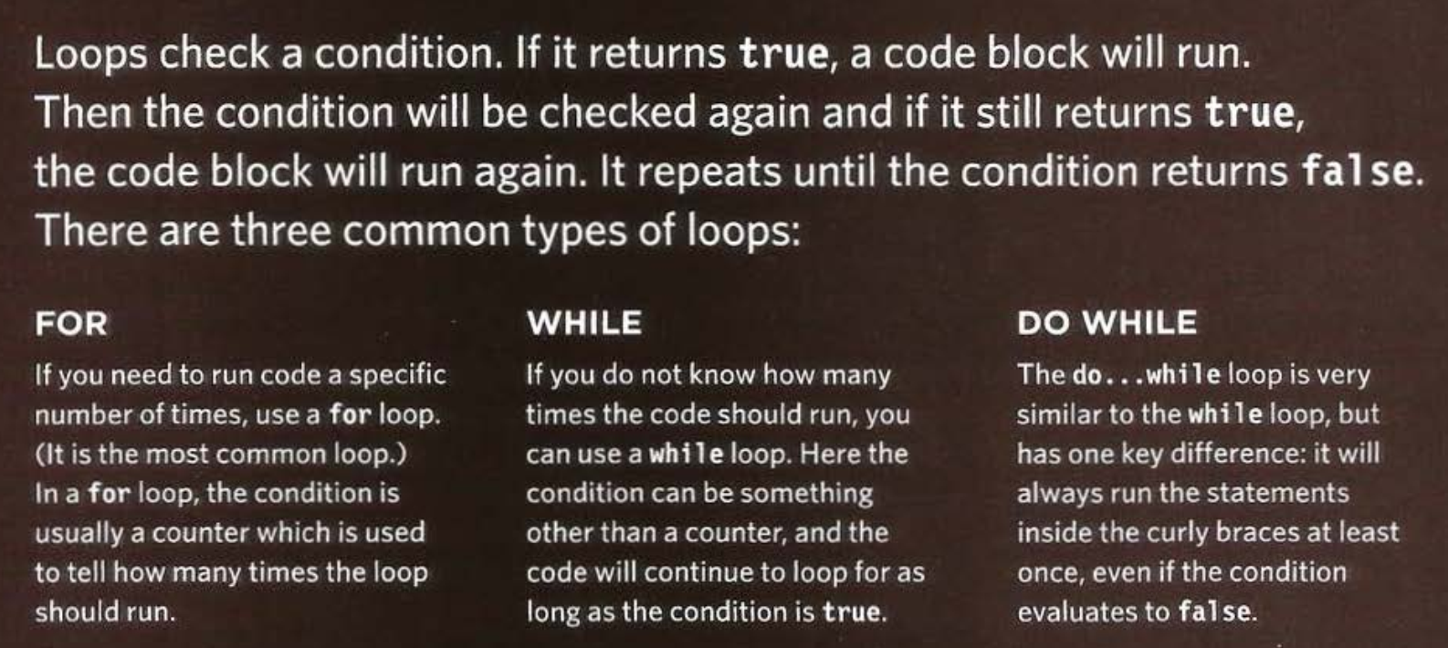
Loops

Slide 33
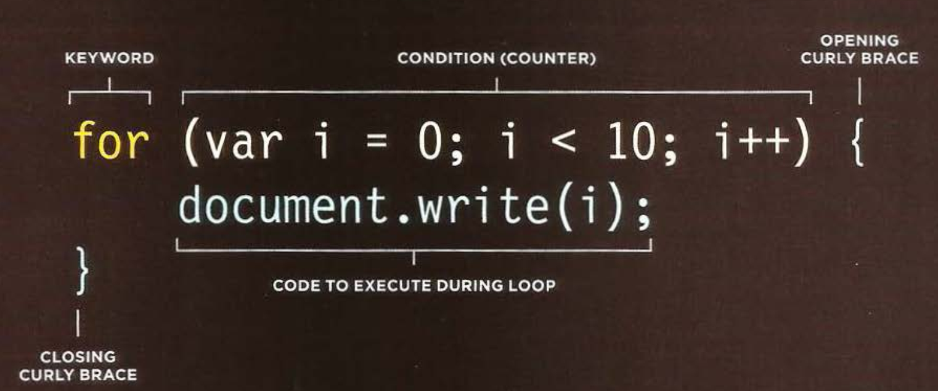
Loop

Slide 34
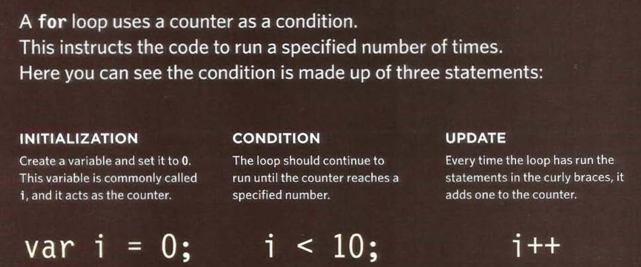
Loop

Slide 35
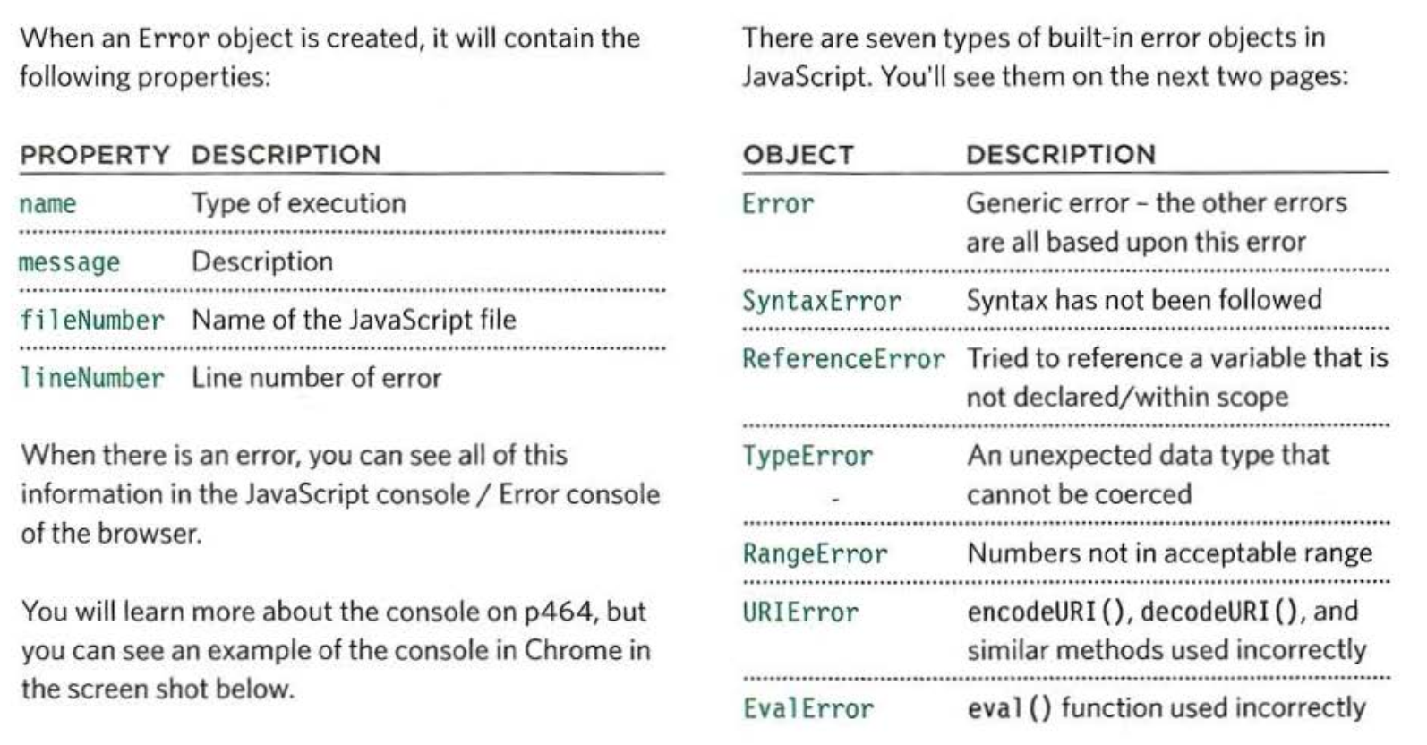
Error Object
﻿Error objects can help you find where your mistakes are and browsers have tools to help you read them.

Slide 36
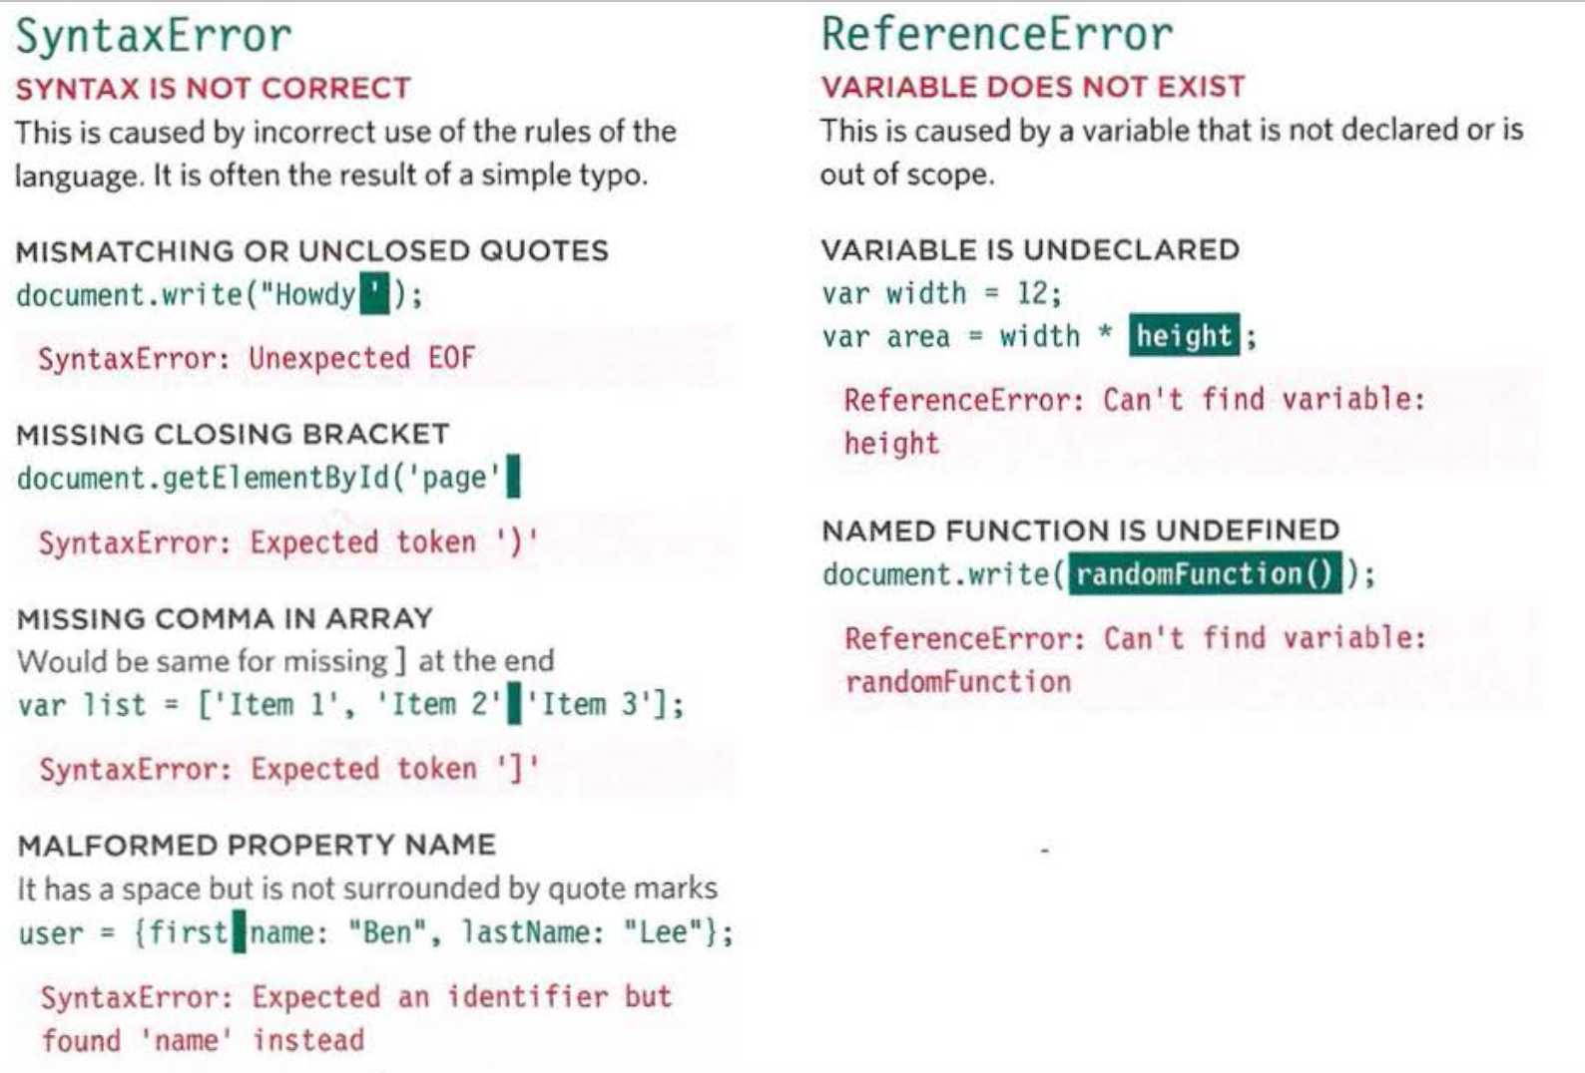
Error Objects continued

Slide 37
Debug on Chrome
How to look at error on Chrome
Typing in the console
Loging data to the console
Breakpoints

Slide 38
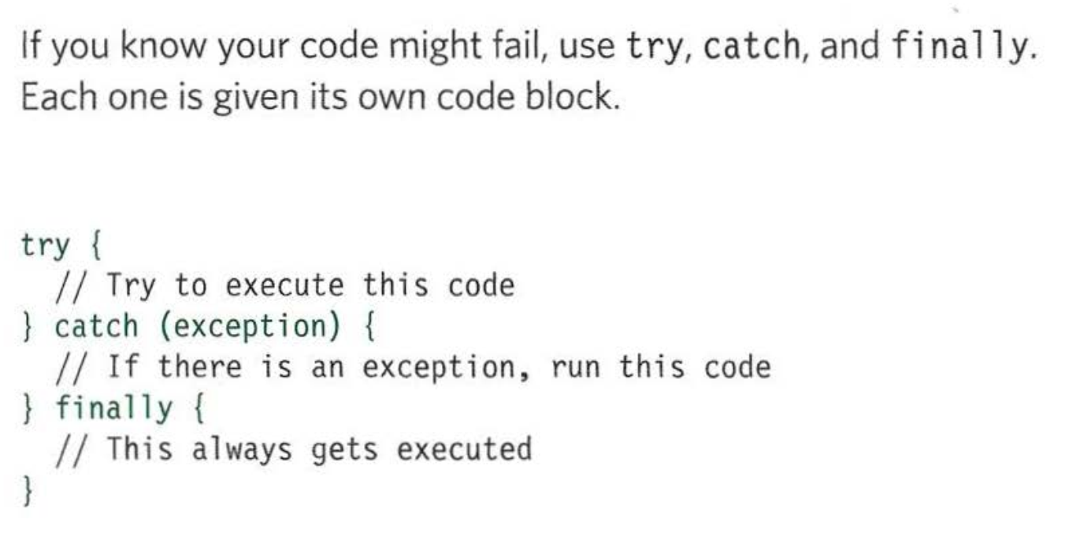
Handling Exception

Slide 39
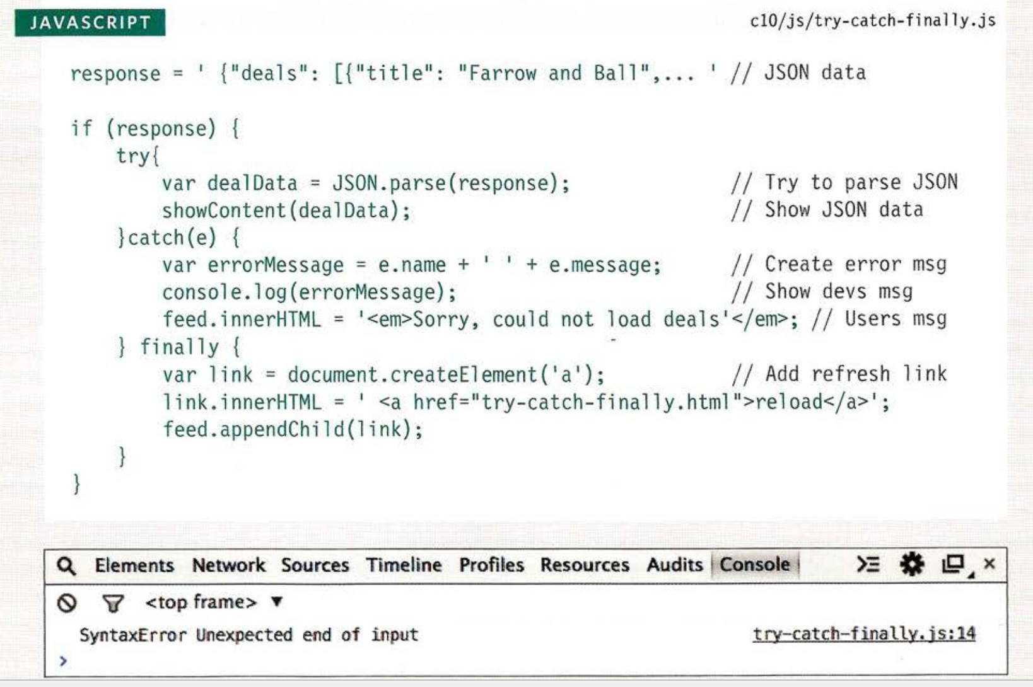
Try, Catch, Finally

Slide 40
Summary and Tasks

